Slide 1
Data-driven projectile motion prediction:
Based on machine learning
Std: 董丞哲、陳彥臻、林沅諭
Date: 2020/05/05

Slide 2
Outline
Problem description & Data distribution
ML models
Workflow and architecture
Model tuning
Results
Final Project Sketch

Slide 3
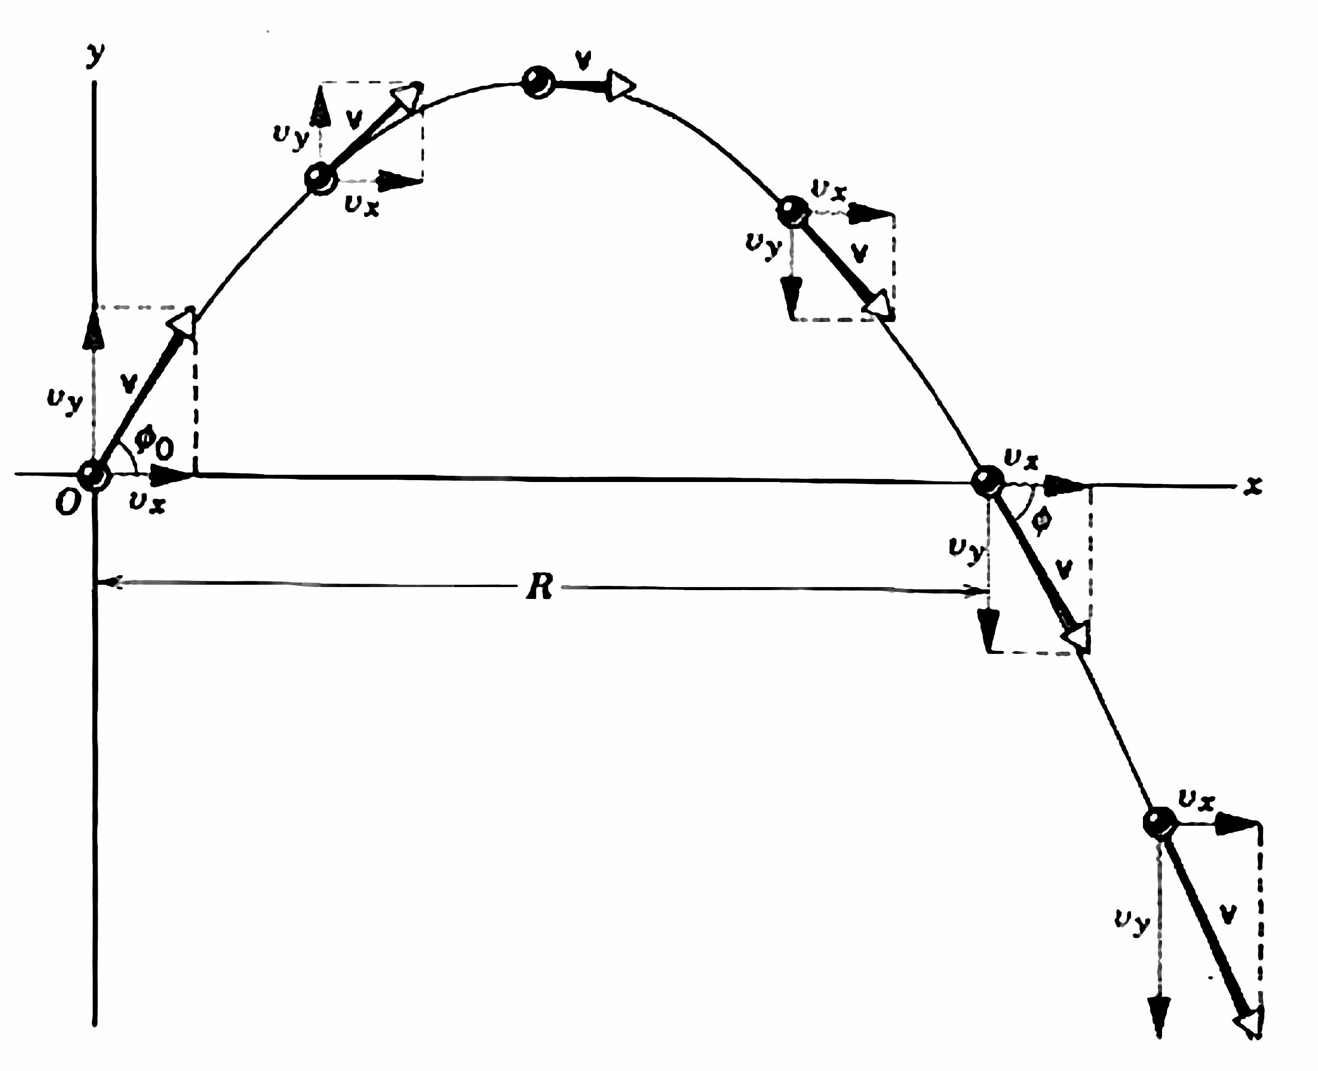
Projectile motion:
Physics and data generation
Basic projectile motion:
θ
Dataset generator
The dataset only contain:
3

Slide 4
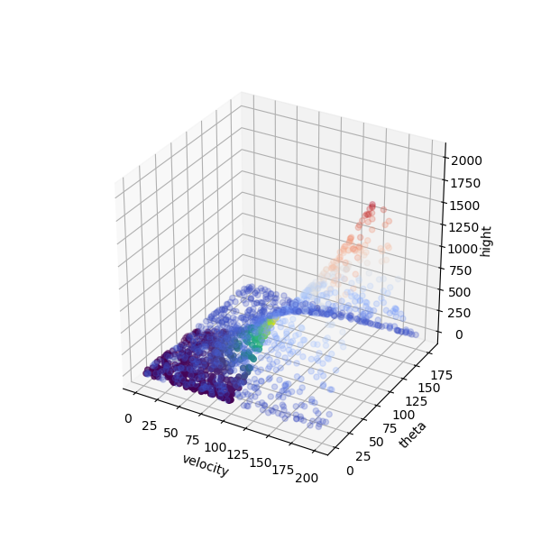
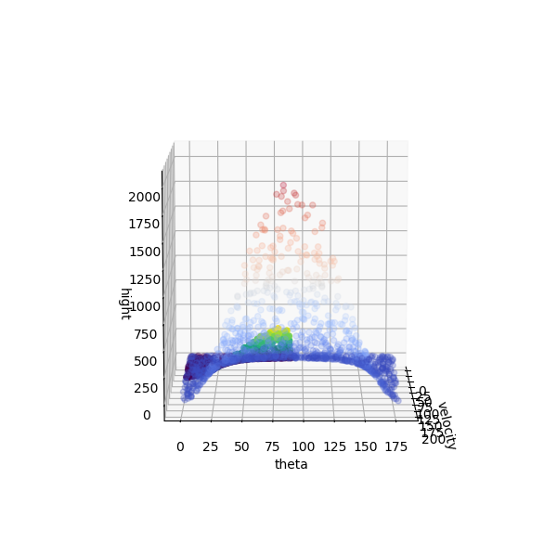
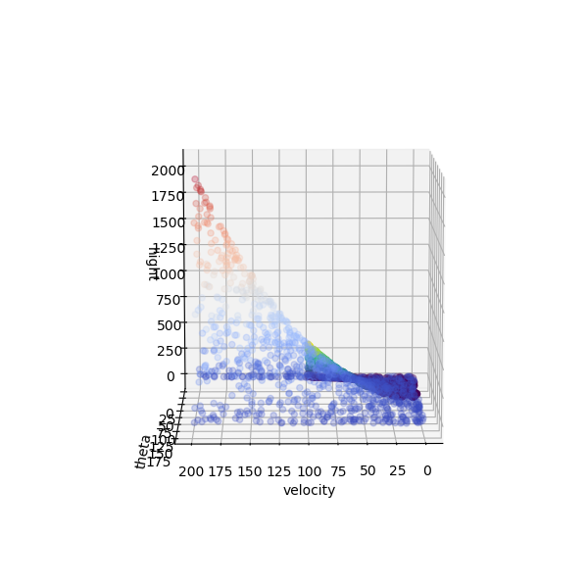
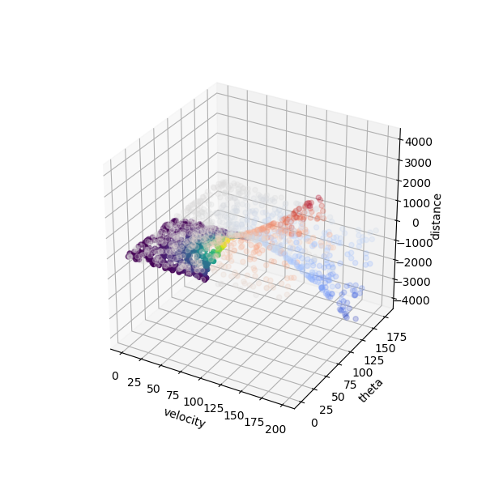
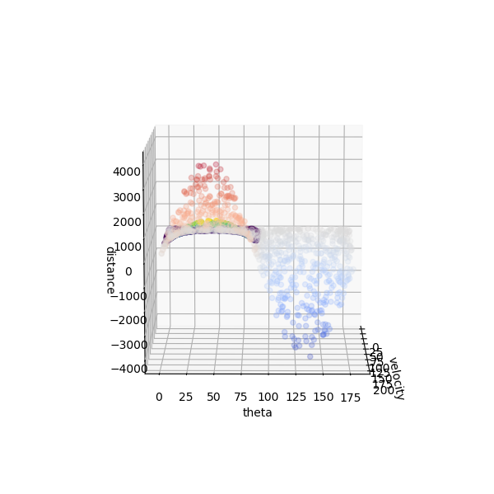
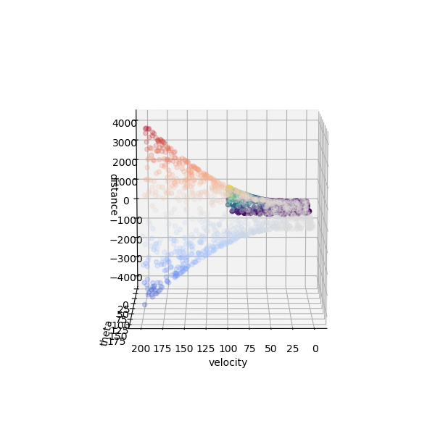
Data-driven prediction:
Data distribution
Hight
Distance
4

Slide 5
Outline
Problem description & Data distribution
ML models
Workflow and architecture
Model tuning
Results
Final Project Sketch

Slide 6
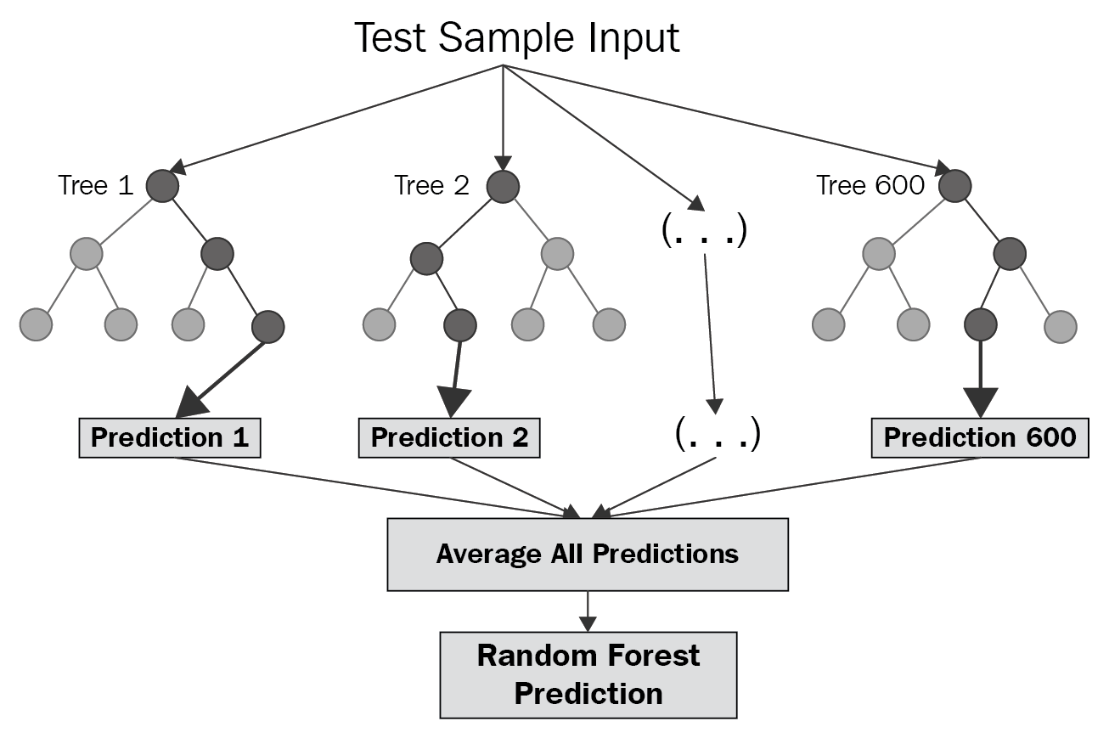
Random Forest:
Fundamental knowledge
6

Slide 7
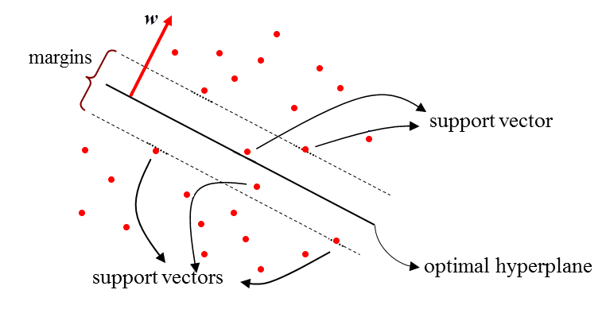
Support Vector Regression, SVR:
Fundamental knowledge
Support Vector Regression
7

Slide 8
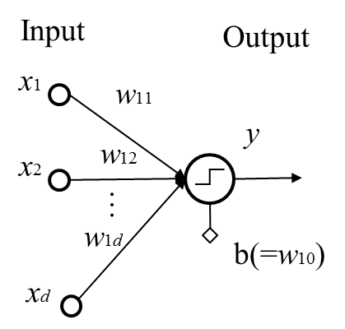
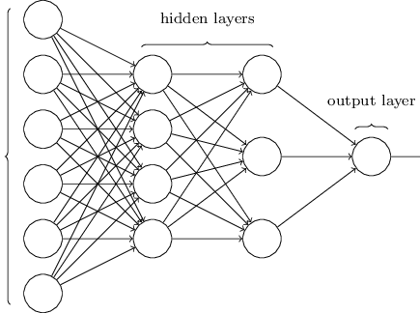
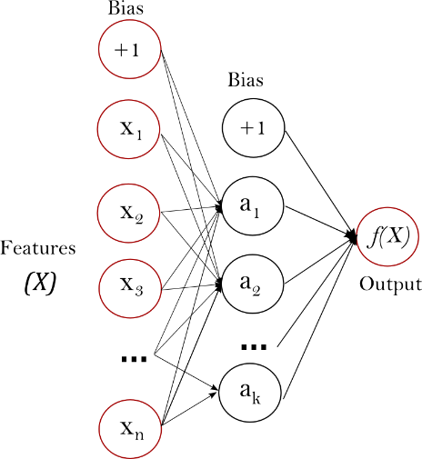
MuLtilayer Perceptron, MLP:
Fundamental knowledge
single perceptron
Features (x)
y’
y
backward propagation
multilayer perceptron
layer perceptron
8

Slide 9
Outline
Problem description & Data distribution
ML models
Workflow and architecture
Model tuning
Results
Final Project Sketch

Slide 10




Projectile motion:
Prediction workflow and architecture
Generator
Fitting
Data Generating
Model Fitting
Calculating
Output data
Fit models
Save models
Main
Parameter setting
Data generation
ML model
Plotting
Models
Plotting
Model Building
Plotting Functions
Random Forest
SVM
MLP
Training curves
Scatter plotting
Usage
GUI
Model Using
User Interface
Data generation
ML model
Plotting
Model choosing
Parameter Input
10

Slide 11




Graphical User Interface:
Testing model technique
Qt Designer
Creating Widget
Button
Label text
Line editor
Saving
UI
UI file (.ui)
Save the object info
PyUI Converter
Main
PyQt5
Python Code
Python file (.py)
Import plotting method
Control the UI
Import
Pythonized object info
11

Slide 12
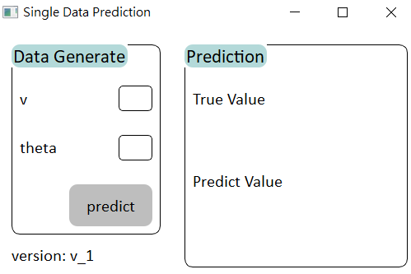
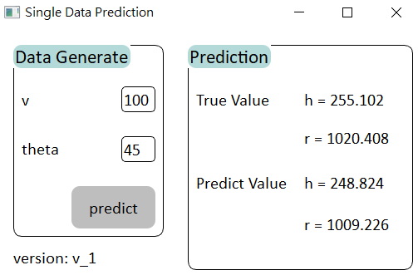
Prediction method A:
Single data
Model imported
A pair of input
V
Θ
Instant True vs. Predict
12

Slide 13
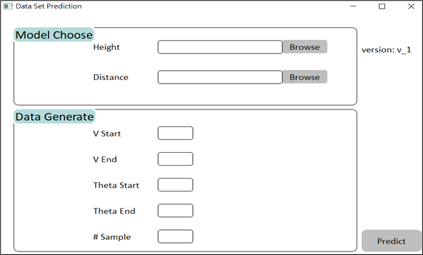
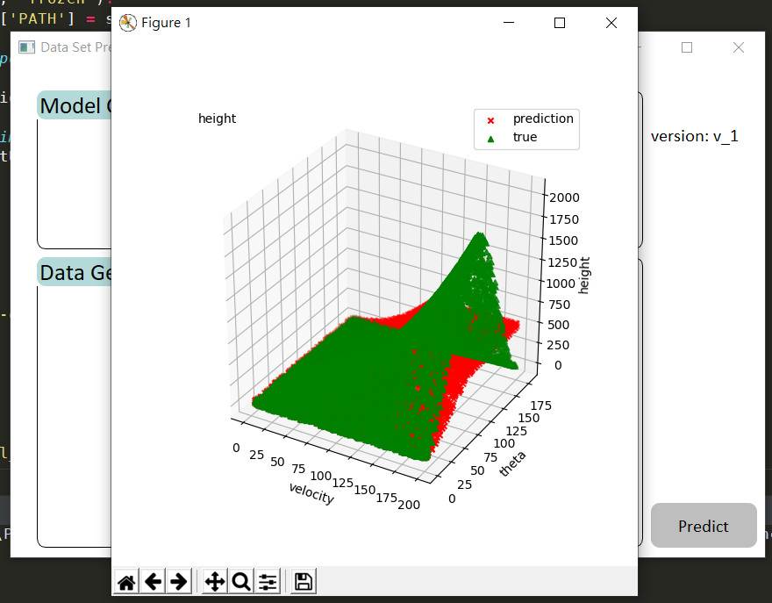
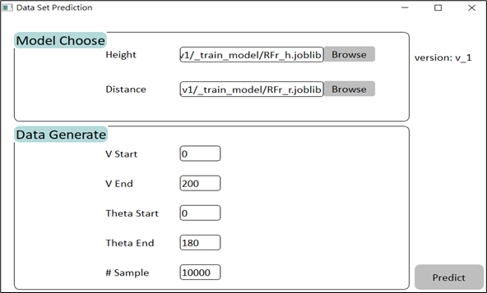
Prediction method B:
Model data set with model Customization
Model import by user
A set of data generate by user
V start
V end
Θ start
Θ end
# Sample
Instant 3D plot
13

Slide 14
Outline
Problem description & Data distribution
ML models
Workflow and architecture
Model tuning
Results
Final Project Sketch

Slide 15
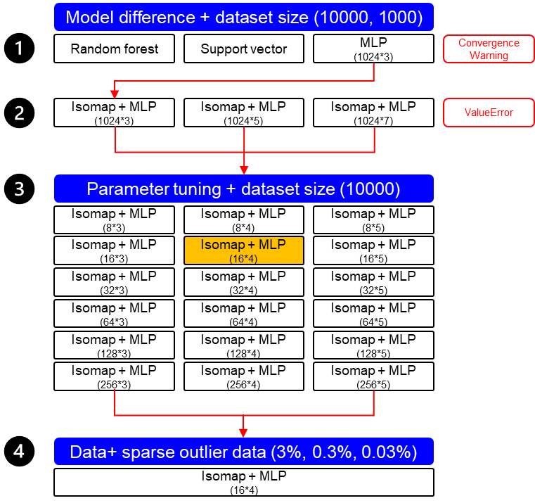
Projectile motion:
Model tuning (based on GridSearch/trial and error)
15

Slide 16
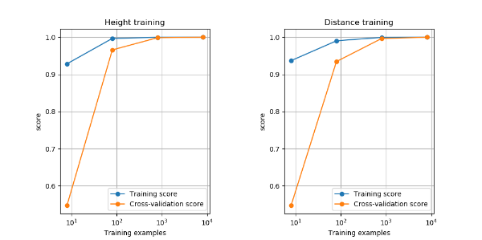
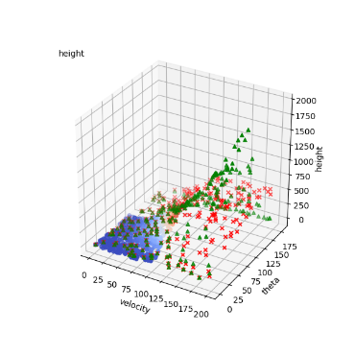
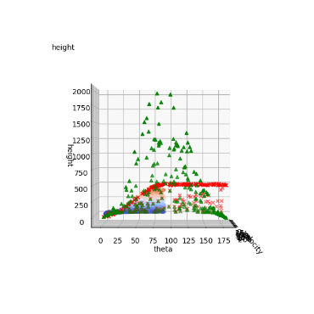
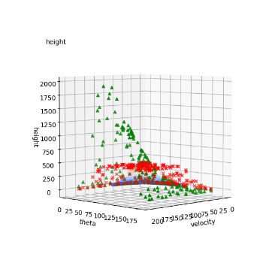
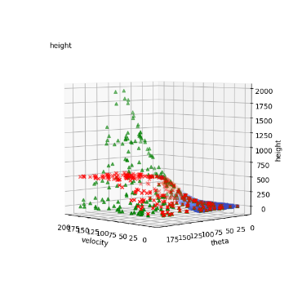
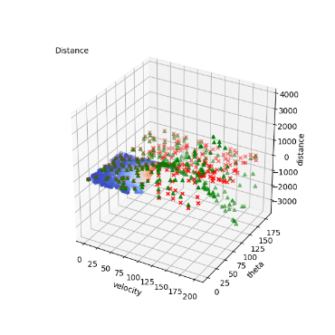
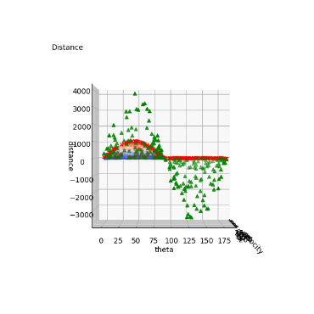
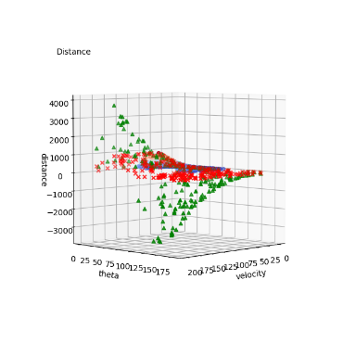
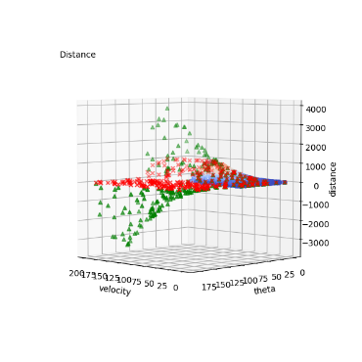
Random Forest Regressor:
Results (data points: 10000)
RFr height cross_val: 2.2988502979278564 sec
RFr height test_score: [0.99988585 0.99988335 0.99989282 0.99989252 0.99986882]
RFr height test_score: 0.9998846722301671
Height
RFr distance cross_val: 1.9797039031982422 sec
RFr distance test_score: [0.99977876 0.99977646 0.99981514 0.99977807 0.9998012 ]
RFr distance test_score: 0.9997899248365666
Distance
16

Slide 17
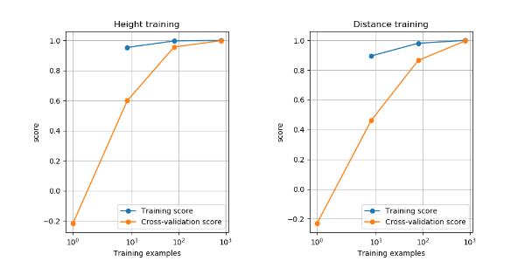
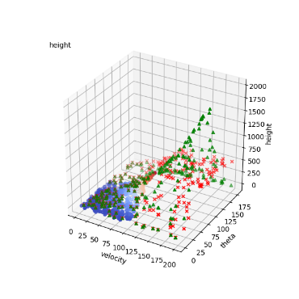
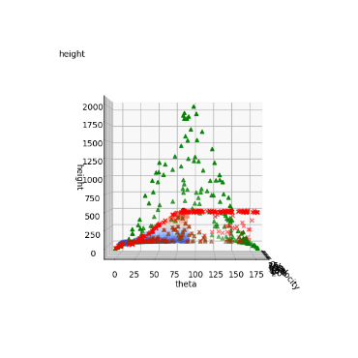
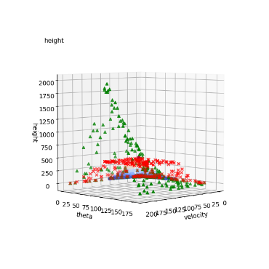
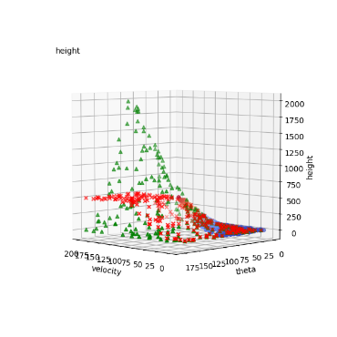
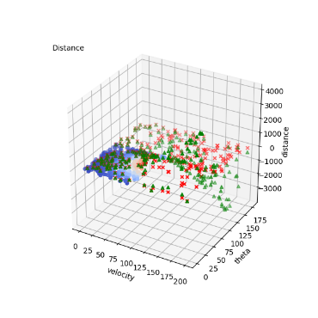
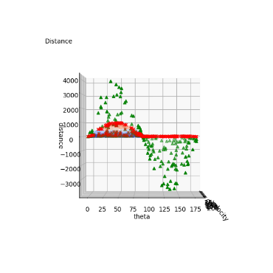
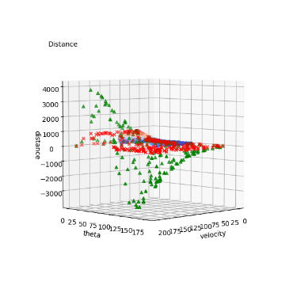
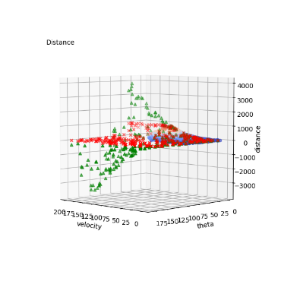
Random Forest Regressor:
Results (data points: 1000)
RFr height cross_val: 1.2247233390808105 sec
RFr height test_score: [0.99907528 0.99821051 0.99817917 0.99810935 0.99838172]
RFr height test_score: 0.9983912062332128
Height
RFr distance cross_val: 0.9115617275238037 sec
RFr distance test_score: [0.99703543 0.99325959 0.99662831 0.9948762 0.99723959]
RFr distance test_score: 0.9958078220611387
Distance
17
Notes:
*10_UndefinedMetricWarning: R^2 score is not well-defined with less than two samples.

Slide 18
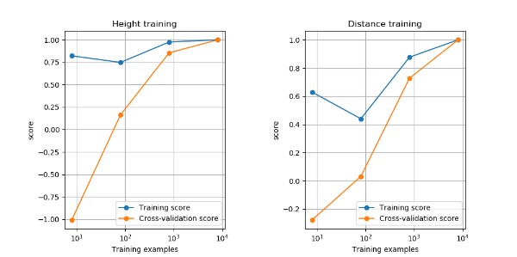
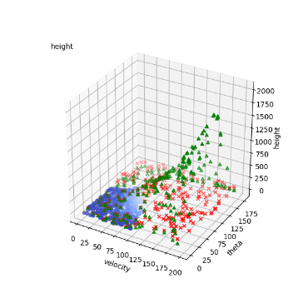
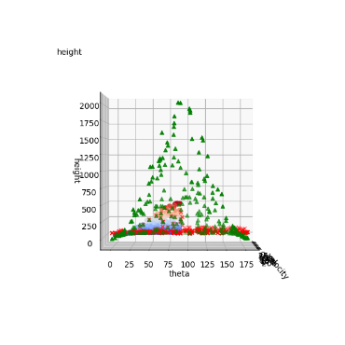
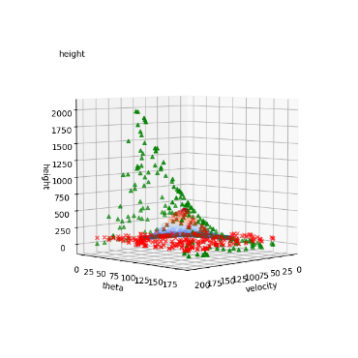
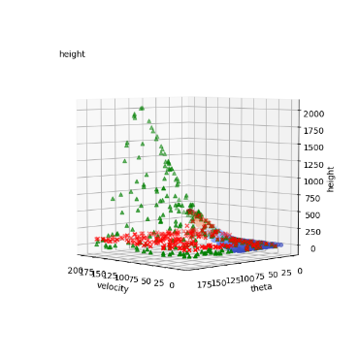
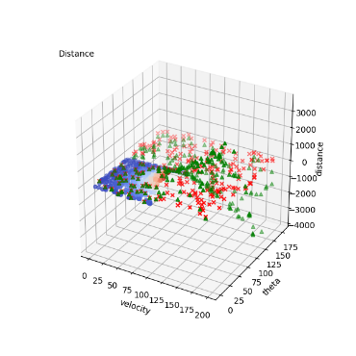
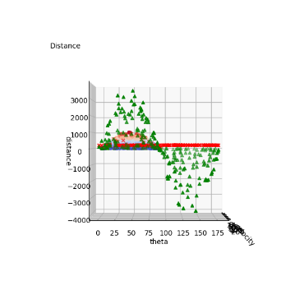
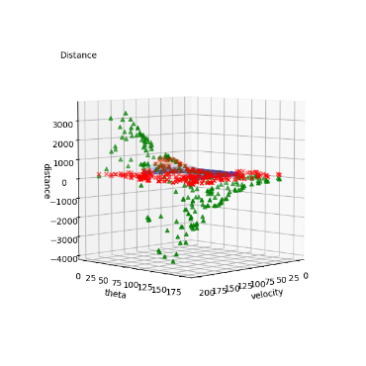
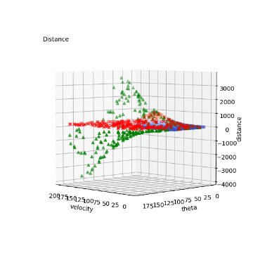
Support Vector Regressor :
Results (data points: 10000)
SVr height cross_val: 92.61825466156006 sec
SVr height test_score: [0.99922734 0.99974869 0.99976963 0.9997936 0.99979417]
SVr height test_score: 0.9996666874278759
Height
SVr distance cross_val: 154.98942112922668 sec
SVr distance test_score: [0.99931396 0.99955356 0.99938299 0.99930989 0.9996898 ]
SVr distance test_score: 0.9994500401511959
Distance
18

Slide 19
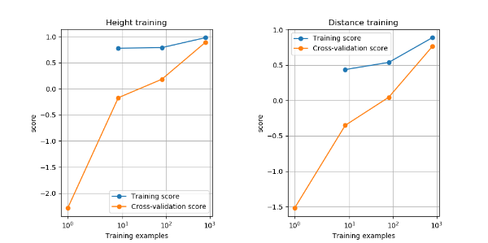
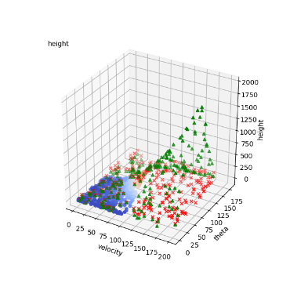
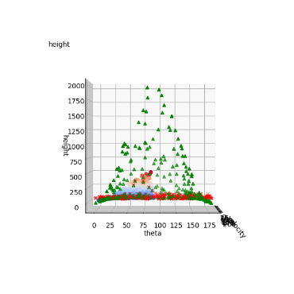
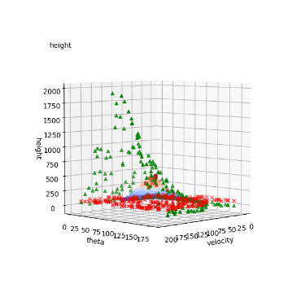
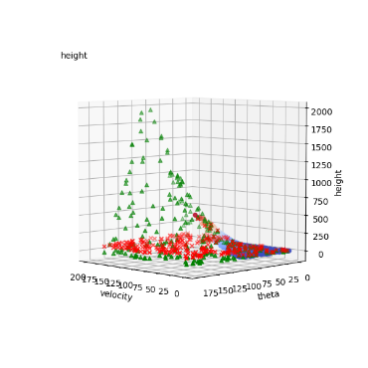




Support Vector Regressor :
Results (data points: 1000)
SVr height cross_val: 1.2815709114074707 sec
SVr height test_score: [0.9005019 0.93399212 0.91345734 0.79470859 0.90329532]
SVr height test_score: 0.8891910536156595
Height
SVr distance cross_val: 0.826789140701294 sec
SVr distance test_score: [0.70807874 0.75378858 0.82603542 0.78774424 0.74003019]
SVr distance test_score: 0.7631354343090091
Distance
19
Notes:
*10_UndefinedMetricWarning: R^2 score is not well-defined with less than two samples.

Slide 20










RFr vs. SVr:
Results (error visualization)
Height
RFr, 1000
RFr, 10000
SVr, 1000
SVr, 10000
Distance
RFr, 1000
RFr, 10000
SVr, 1000
SVr, 10000
20

Slide 21









MLPr_3 (1024*3):
Results (data points: 10000)
MLPr_3_r height cross_val: 595.2318279743195 sec
MLPr_3 height test_score: [0.9989881 0.99886549 0.98944222 0.99631857 0.99952458]
MLPr_3 height test_score: 0.9966277919121875
Height
MLPr_3_r distance cross_val: 993.4995121955872 sec
MLPr_3 distance test_score: [0.99644541 0.99782423 0.99944101 0.99811278 0.9974251 ]
MLPr_3 distance test_score: 0.9978497085266778
Distance
21
Notes:
*14_ ConvergenceWarning: Stochastic Optimizer: Maximum iterations (200) reached and the optimization hasn't converged yet.

Slide 22









MLPr_3 (1024*3):
Results (data points: 1000)
MLPr_3_r height cross_val: 113.68306565284729 sec
MLPr_3 height test_score: [0.9748605 0.93242745 0.98472004 0.99688511 0.95789886]
MLPr_3 height test_score: 0.9693583927338185
Height
MLPr_3_r distance cross_val: 172.04708003997803 sec
MLPr_3 distance test_score: [0.95042859 0.94714063 0.95893979 0.92802037 0.96389417]
MLPr_3 distance test_score: 0.9496847129424417
Distance
22
Notes:
*10_UndefinedMetricWarning: R^2 score is not well-defined with less than two samples.
*10_ ConvergenceWarning: Stochastic Optimizer: Maximum iterations (200) reached and the optimization hasn't converged yet.

Slide 23
Projectile motion:
Model tuning (based on GridSearch/trial and error)
23

Slide 24

Isomap:
Fundamental knowledge
Nonlinear dimensionality reduction
Determine the neighbors of each point.
All points in some fixed radius.
K nearest neighbors.
Construct a neighborhood graph.
Each point is connected to other if it is a K nearest neighbor.
Edge length equal to Euclidean distance.
Compute shortest path between two nodes.
Dijkstra's algorithm
Compute lower-dimensional embedding.
Multidimensional scaling
24

Slide 25









MLPr_i3 (1024*3):
Results (data points: 10000)
MLPr_i3_r height cross_val: 909.9167439937592 sec
MLPr_i3_h height test_score: [0.99886395 0.99918727 0.99890468 0.9978896 0.99930294]
MLPr_i3_h height test_score: 0.99882968874263
Height
MLPr_i3_r distance cross_val: 1041.7665178775787 sec
MLPr_i3_r distance test_score: [0.99724306 0.99837401 0.99768439 0.99611349 0.99794305]
MLPr_i3_r distance test_score: 0.9974716009253104
Distance
25
Notes:
*08_ ConvergenceWarning: Stochastic Optimizer: Maximum iterations (200) reached and the optimization hasn't converged yet.

Slide 26








MLPr_i3 (1024*3):
Results (data points: 1000)
MLPr_i3_r height cross_val: 133.35898184776306 sec
MLPr_i3_h height test_score: [0.99370104 0.98871669 0.99203654 0.99548624 0.99505624]
MLPr_i3_h height test_score: 0.9929993509420487
Height
MLPr_i3_r distance cross_val: 122.06869125366211 sec
MLPr_i3_r distance test_score: [0.98059377 0.96455087 0.98355294 0.97862832 0.97630865]
MLPr_i3_r distance test_score: 0.9767269078670486
Distance
26
Notes:
*ValueError: Expected n_neighbors <= n_samples, but n_samples = 1, n_neighbors = 6

Slide 27








MLPr (1024*3) vs. MLPr (isomap + 1024*3):
Results (error visualization)
Height
MPLr_3, 1000
MPLr_3, 10000
MPLr_i3, 1000
MPLr_i3, 10000
Distance
MPLr_3, 1000
MPLr_3, 10000
MPLr_i3, 1000
MPLr_i3, 10000
27

Slide 28









MLPr_i5 (1024*5):
Results (data points: 10000)
MLPr_i5 height cross_val: 1161.0156428813934 sec
MLPr_i5_h height test_score: [0.99789958 0.99894851 0.9992174 0.99751551 0.99902531]
MLPr_i5_h height test_score: 0.9985212647204268
Height
MLPr_i5 distance cross_val: 1081.8008790016174 sec
MLPr_i5_r distance test_score: [0.99775436 0.99614237 0.99511936 0.99633093 0.99650206]
MLPr_i5_r distance test_score: 0.99636981694859
Distance
28

Slide 29








MLPr_i5 (1024*5):
Results (data points: 1000)
MLPr_i5 height cross_val: 1056.3523898124695 sec
MLPr_i5_h height test_score: [0.99886217 0.99037355 0.99925496 0.99775953 0.99917187]
MLPr_i5_h height test_score: 0.9970844190999095
Height
MLPr_i5 distance cross_val: 901.6432173252106 sec
MLPr_i5_r distance test_score: [0.9984008 0.99746372 0.99668738 0.99787126 0.99516266]
MLPr_i5_r distance test_score: 0.9971171644851248
Distance
29
Notes:
*ValueError: Expected n_neighbors <= n_samples, but n_samples = 1, n_neighbors = 6

Slide 30









MLPr_i7 (1024*7):
Results (data points: 10000)
MLPr_i7 height cross_val: 1836.5076785087585 sec
MLPr_i7_h height test_score: [0.99912773 0.99811092 0.99888773 0.99848948 0.99929757]
MLPr_i7_h height test_score: 0.9987826860004618
Height
MLPr_i7 distance cross_val: 1966.8651599884033 sec
MLPr_i7_r distance test_score: [0.99851341 0.9977633 0.99813468 0.99844495 0.99721736]
MLPr_i7_r distance test_score: 0.9980147377637113
Distance
30

Slide 31








MLPr_i7 (1024*7):
Results (data points: 1000)
MLPr_i7 height cross_val: 1943.1660587787628 sec
MLPr_i7_h height test_score: [0.99796716 0.99740599 0.99739096 0.99929035 0.99798516]
MLPr_i7_h height test_score: 0.998007924982126
Height
MLPr_i7 distance cross_val: 1663.768835067749 sec
MLPr_i7_r distance test_score: [0.99687182 0.99274812 0.99878118 0.99525462 0.98990658]
MLPr_i7_r distance test_score: 0.9947124626366828
Distance
31
Notes:
*ValueError: Expected n_neighbors <= n_samples, but n_samples = 1, n_neighbors = 6

Slide 32








MLPr (isomap + 1024*5) vs. MLPr (isomap + 1024*7):
Results (error visualization)
Height
MPLr_i5, 1000
MPLr_i5, 10000
MPLr_i7, 1000
MPLr_i7, 10000
Distance
MPLr_i5, 1000
MPLr_i5, 10000
MPLr_i7, 1000
MPLr_i7, 10000
32

Slide 33
Projectile motion:
Model tuning (based on GridSearch/trial and error)
33

Slide 34
Projectile motion:
Model tuning (based on GridSearch/trial and error)
34

Slide 35









MLPr (isomap + 16*4):
Results (data points: 10000, 0, 0, 0, (0%))
Height cross_val: 35.07508659362793 sec
Height test_score: [0.99947198 0.99936715 0.99925685 0.99938461 0.99933501]
Height test_score: 0.9993631179659227
Height
Distance cross_val: 32.31456160545349 sec
Distance test_score: [0.99794481 0.99766442 0.99821054 0.99797325 0.99747413]
Distance test_score: 0.9978534294950178
Distance
35

Slide 36









MLPr (isomap + 16*4):
Results (data points: 9997, 1, 1, 1, (0.03%))
Height cross_val: 32.44322371482849 sec
Height test_score: [0.99891361 0.9989387 0.99834963 0.99871614 0.99272932]
Height test_score: 0.9975294789067914
Height
Distance cross_val: 32.744407176971436 sec
Distance test_score: [0.99535074 0.9956172 0.99571924 0.99621095 0.95383718]
Distance test_score: 0.9873470600820193
Distance
36

Slide 37









MLPr (isomap + 16*4):
Results (data points: 9970, 10, 10, 10, (0.3%))
Height cross_val: 32.609949350357056 sec
Height test_score: [0.99784107 0.99833966 0.99722961 0.99135854 0.74995364]
Height test_score: 0.9469445050188108
Height
Distance cross_val: 32.80756592750549 sec
Distance test_score: [0.99599494 0.99462479 0.99525598 0.99421145 0.85644364]
Distance test_score: 0.9673061604605351
Distance
37

Slide 38









MLPr (isomap + 16*4):
Results (data points: 9700, 100, 100, 100, (3%))
Height cross_val: 33.61411094665527 sec
Height test_score: [0.99744454 0.99645815 0.99654502 0.99192897 0.53536601]
Height test_score: 0.9035485365579875
Height
Distance cross_val: 32.55492043495178 sec
Distance test_score: [0.98736768 0.99189169 0.98723831 0.98780694 0.69748225]
Distance test_score: 0.9303573745759351
Distance
38

Slide 39








MLPr (isomap + 16*4):
Results (error and sparse outlier data)
Height
1.0
0.8
0.6
0.4
0.2
(10000, 0, 0, 0, (0%))
(9997, 1, 1, 1, (0.03%))
(9970, 10, 10, 10, (0.3%))
(9700, 100, 100, 100, (3%))
0.0
Distance
(10000, 0, 0, 0, (0%))
(9997, 1, 1, 1, (0.03%))
(9970, 10, 10, 10, (0.3%))
(9700, 100, 100, 100, (3%))
39

Slide 40








MLPr (isomap + 16*4):
Results (predict velocity = 1000)
Height
1.0
MLPr (isomap + 16*4, w/o outlier)
MLPr (isomap + 16*4, 3% outlier)
0.8
0.6
0.4
0.2
(9997, 1, 1, 1, (0.03%))
(9970, 10, 10, 10, (0.3%))
(9700, 100, 100, 100, (3%))
0.0
Distance
MLPr (isomap + 16*4, w/o outlier)
MLPr (isomap + 16*4, 3% outlier)
(9970, 10, 10, 10, (0.3%))
(9700, 100, 100, 100, (3%))
40

Slide 41










MLPr:
Results (structural differences)
Height
MLPr (1024*3)
MLPr (isomap + 1024*3)
MLPr (isomap + 1024*5)
MLPr (isomap + 1024*7)
MLPr (isomap + 16*4)
Distance
MLPr (1024*3)
MLPr (isomap + 1024*3)
MLPr (isomap + 1024*5)
MLPr (isomap + 1024*7)
MLPr (isomap + 16*4)
41

Slide 42
Outline
Problem description & Data distribution
Workflow and architecture
ML models
Model tuning
Results
Final Project Sketch

Slide 43
Final project proposal I:
AI-based porous structure mechanical property predictor
Std: 董丞哲、陳彥臻、林沅諭
Date: 2020/05/05

Slide 44

Introduction
Lightweight structures from nature
Most of Biological Materials: Density < 3 g/cm³ → Lightweight
44
‘Materials Selection in Mechanical Design’, by M.F. Ashby.

Slide 45







Problem descriptions
Slow finite element simulation
Compression
Stress: xx
0.01
- Solid material
- Hole
30
0
128
Tension
Stress: xx
256
0.05
Elastic modulus: 0.25
Poisson's ratio: 0.15
30
-0.05
45

Slide 46




Workflow
AI-based FEM-like mechanical property predictor
FEM/slow
Modeling
Definition
Calculation
Result
Structure
Seeding
Basic solvers
Stress
Material
Meshing
Linear solvers
Strain
Material properties
BCs
Nonlinear solvers
Deformation
Modeling
Definition
Calculation
Result
Image-based
BCs
ML models
Stress
Material
Strain
Material properties
Deformation
46

Slide 47





Expected problems
Features
Simulation costs
5
5
5
Direct images or preprocessed features?
15 min for 256*128 elements
Data correlations
Accuracy
How to define accuracy?
Local or general?
How to correlate structure and value after predict?
47

Slide 48

Final project proposal II:
Order predictor Ver 0.0
Midterm Report
Std: 董丞哲、陳彥臻、林沅諭
Date: 2020/05/05
5345機器學習於材料資訊的應用
Machine Learning on Material Informatics

Slide 49


Order_pred ver 0.0 :
From XRD pattern predict Crystal Structure
XRD
pattern
Crystal
Structure
Model
Data
49

Slide 50


Order_pred ver 0.0 :
From XRD pattern predict Crystal Structure
XRD
pattern
Crystal
Structure
Model
Data
50

Slide 51

Order_pred ver 0.0 :
From XRD pattern predict Crystal Structure
51

Slide 52
Thank You for Attention Any Question?

